Slide 1



Slide 2
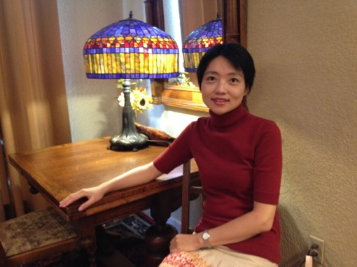
Getting to Know Me
My name is 奚健(Ms Xi)。
I come from China.
This is my 5th year in Rogers and 15th year in teaching.
I look forward to sharing Chinese language and culture with my students!

Slide 3
Course Description:
This course is designed to introduce students to Chinese language and culture, and to lay a solid foundation for their further Chinese study. For this year, students will learn some topics of everyday life, the vocabulary related to the topics, and the sentence structures they need to communicate about the topics. Also students will have many opportunities to experience Chinese culture such as learning about Chinese calligraphy, paper cutting, etc.

Slide 4
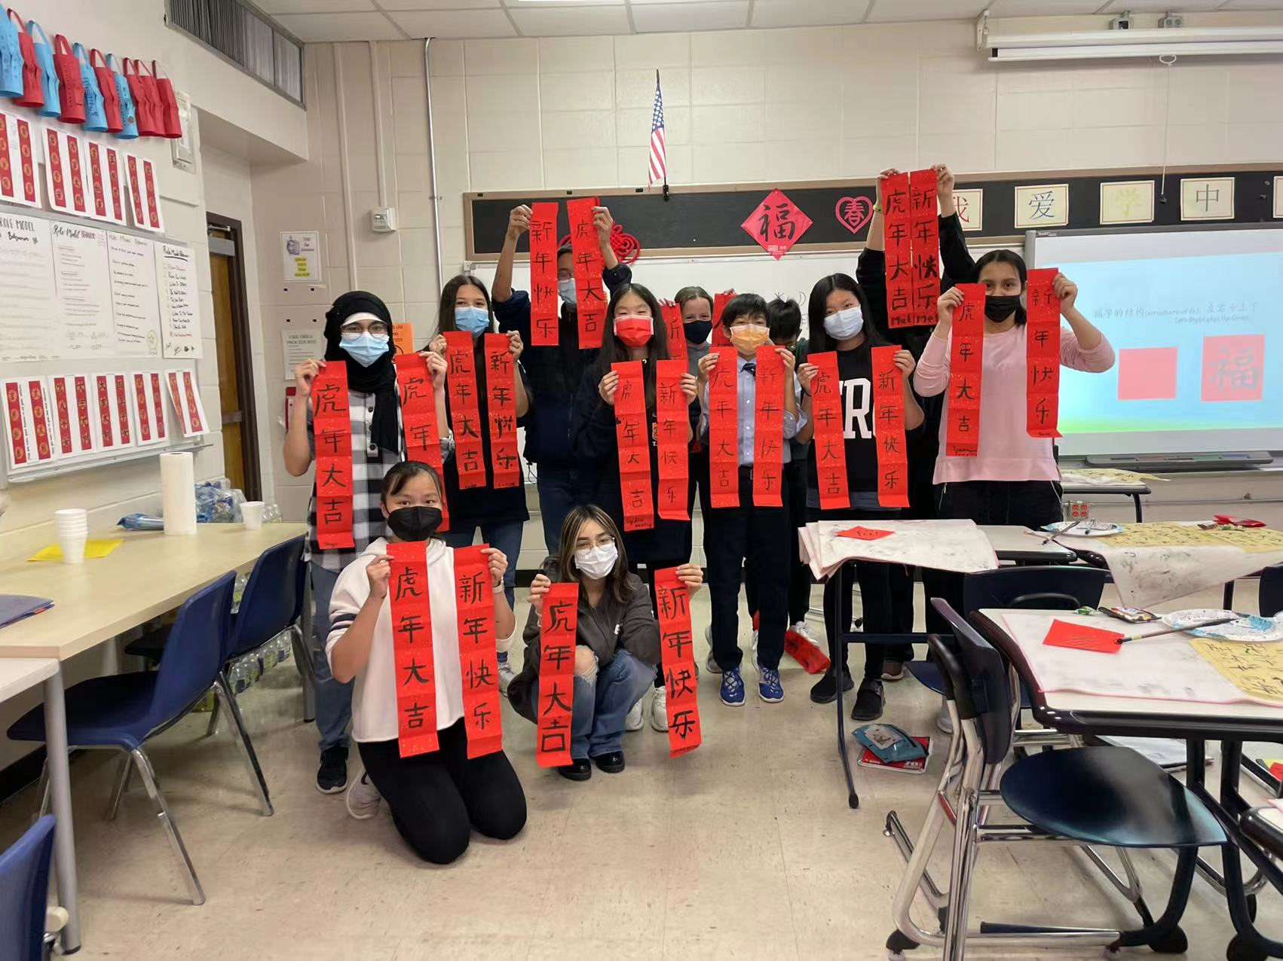
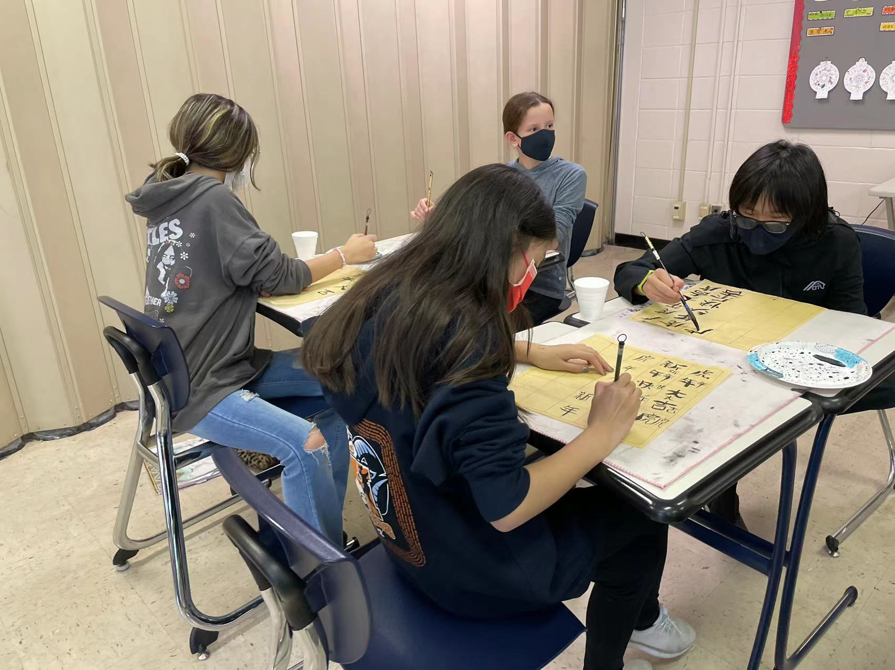

Slide 5
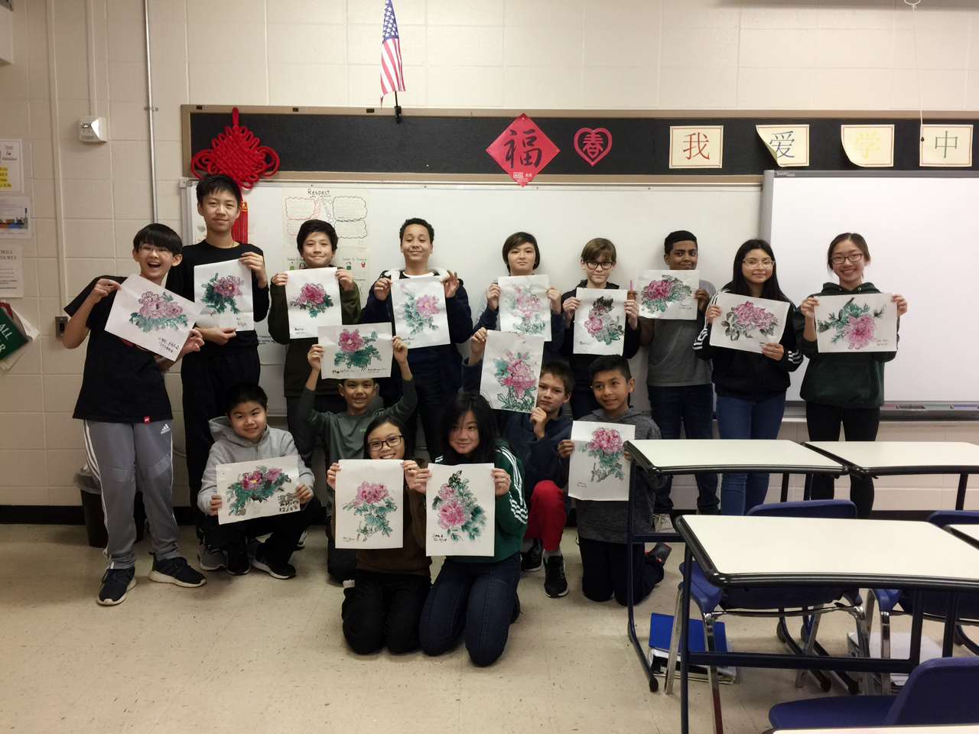
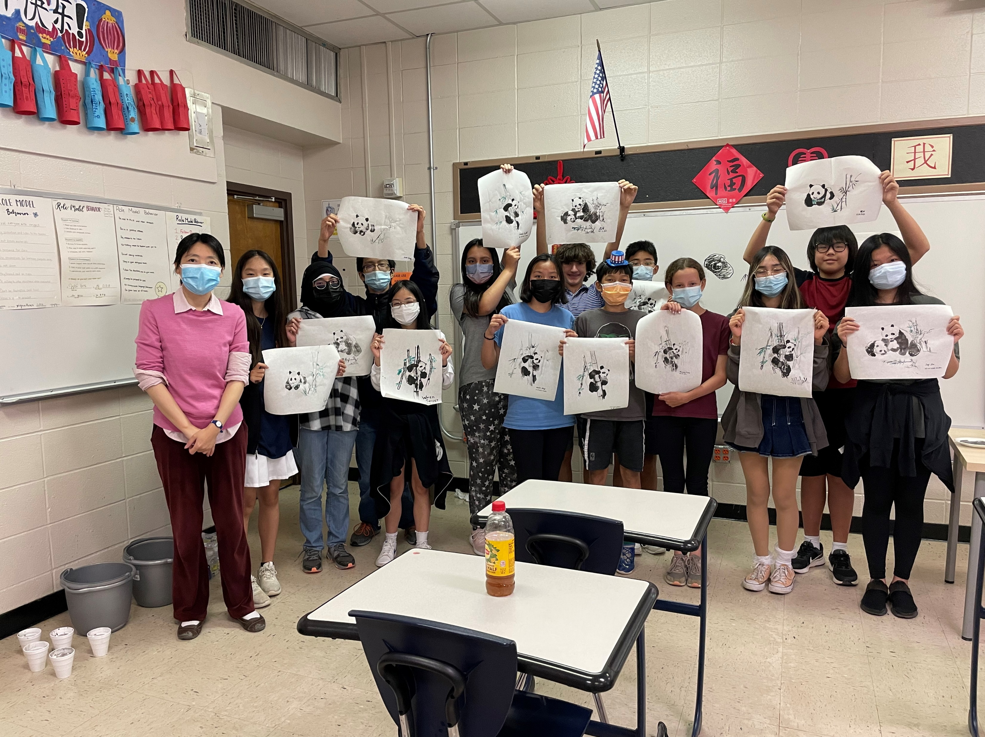

Slide 6
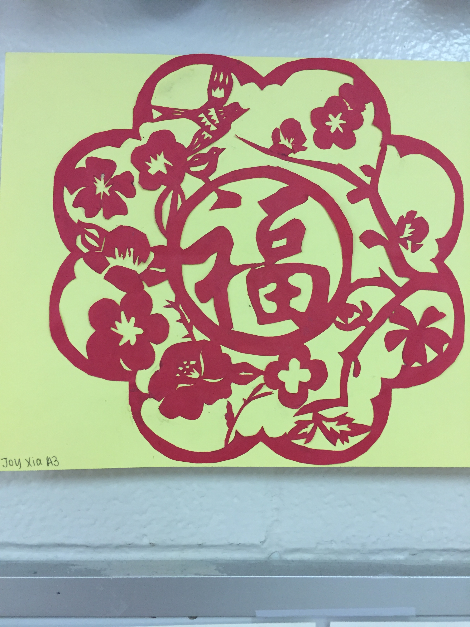
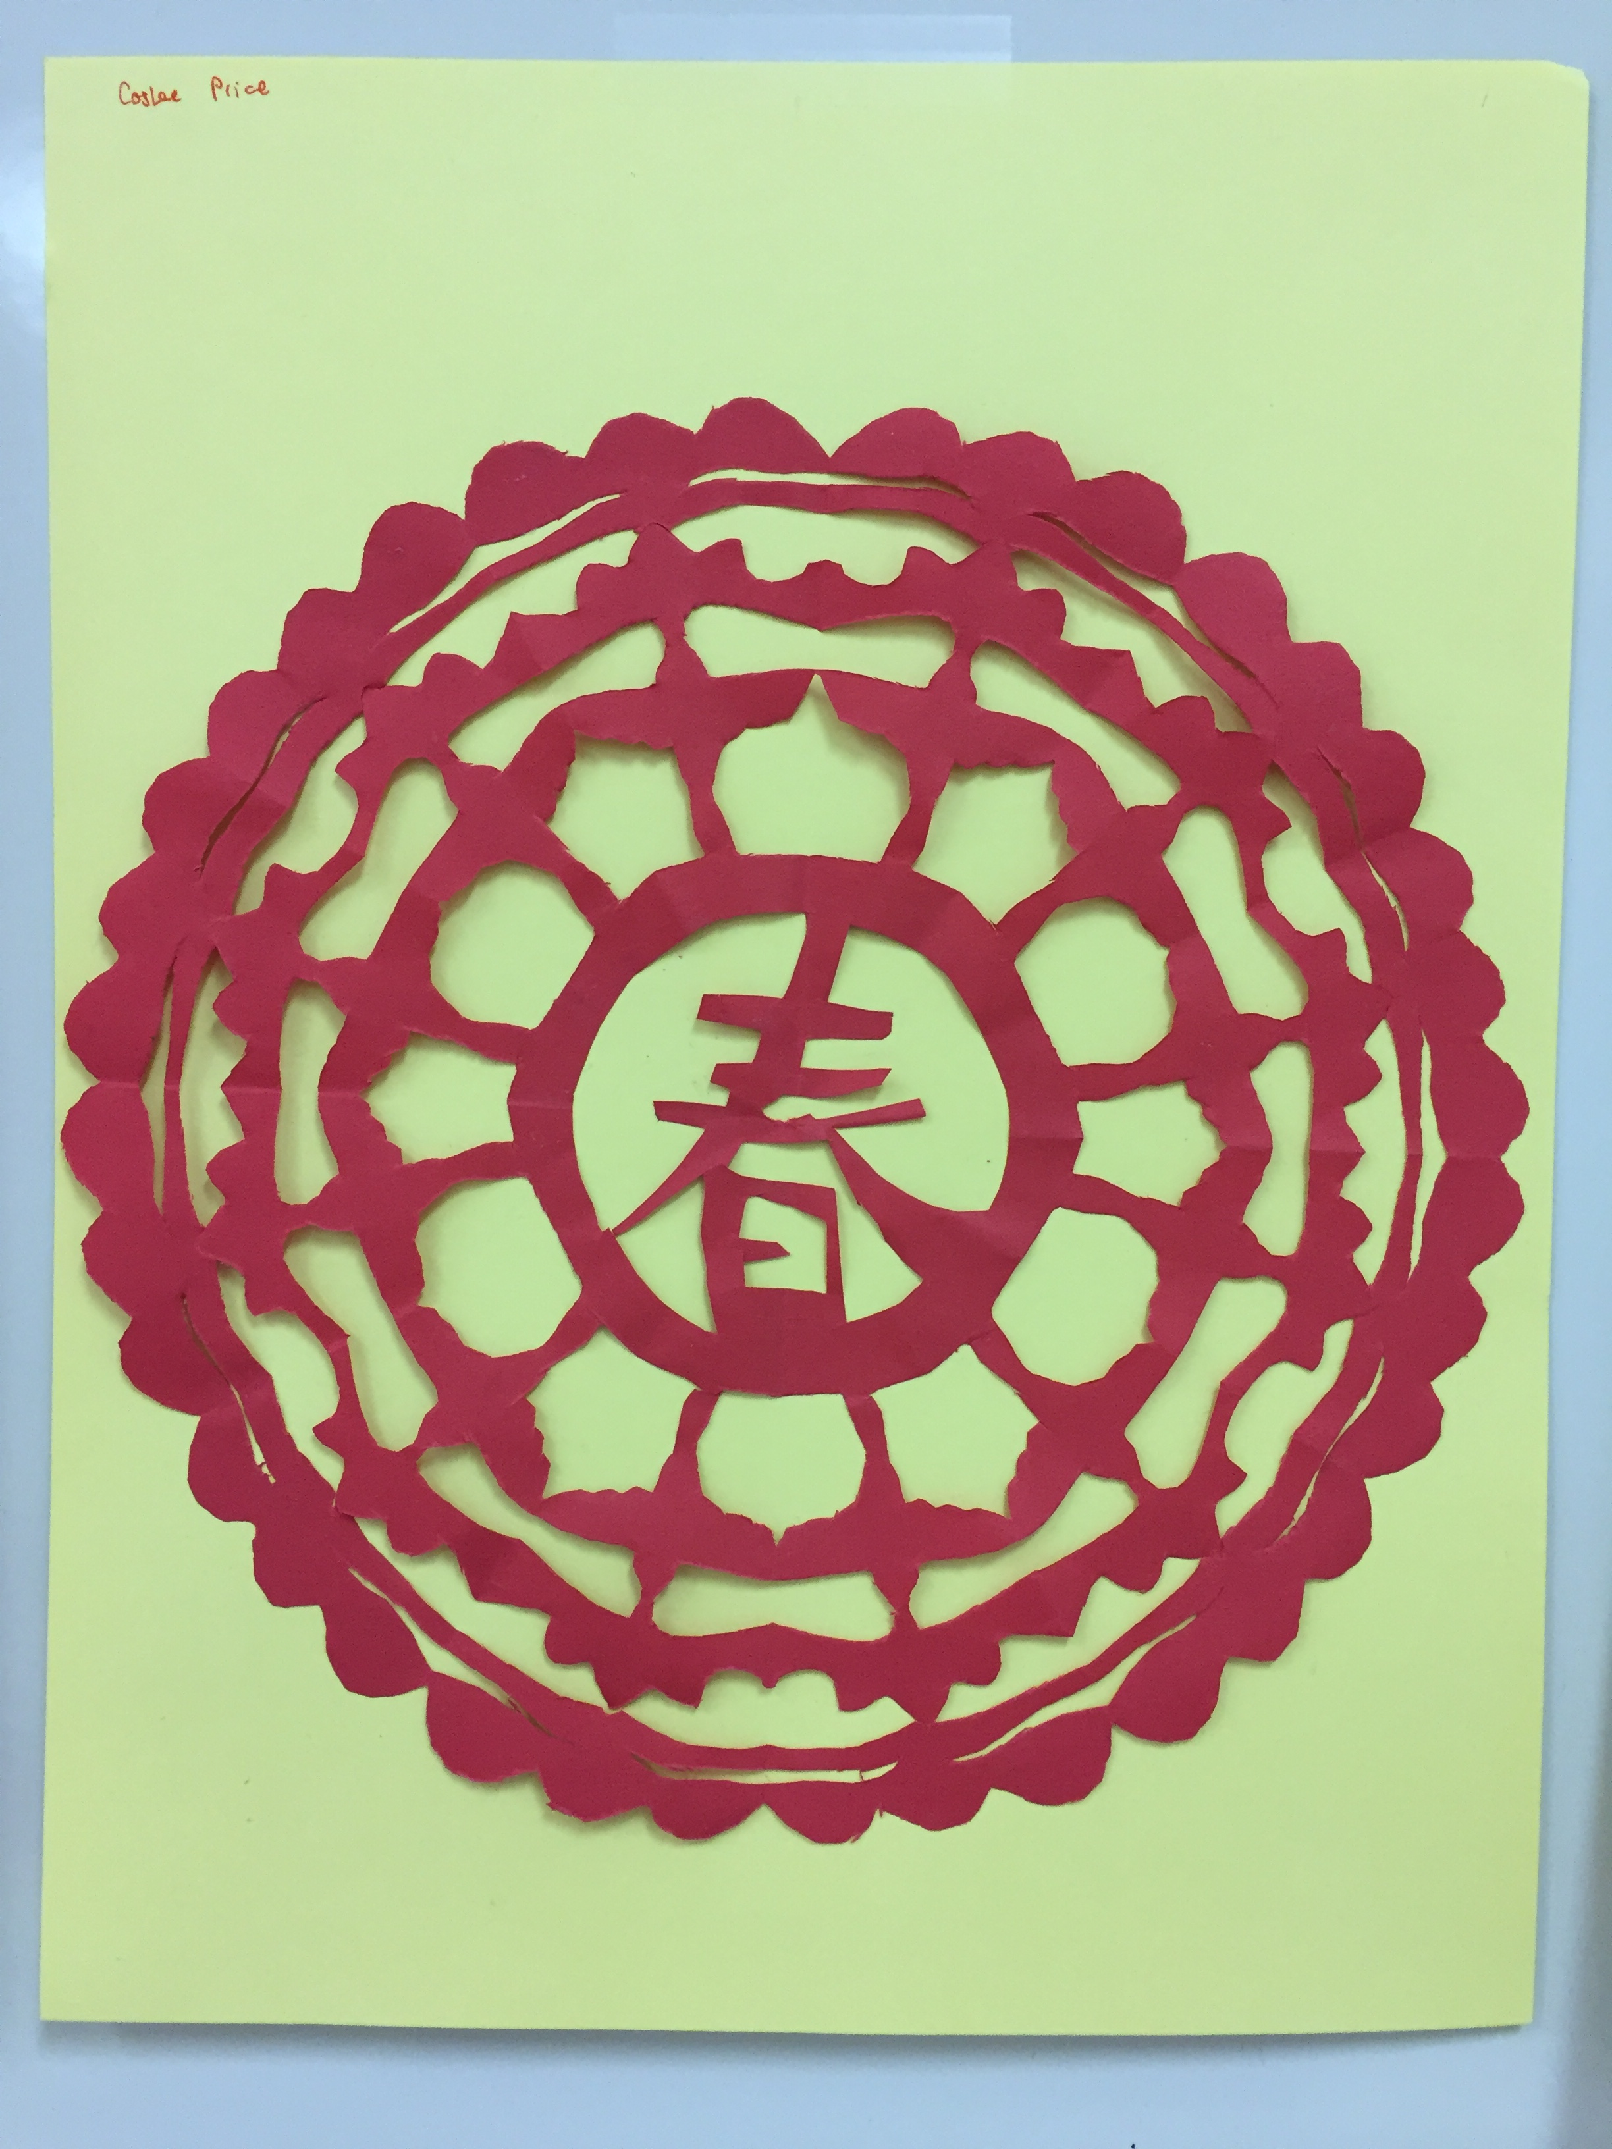

Slide 7
Grading Policy:
Learning (homework, classwork, quizzes, etc) will count for 70% of a student’s overall average for each cycle.
Assessments (projects, tests, etc) will count for 30% of a student’s overall average for each cycle.

Slide 8
Final Exam:
This is a high school credit course, so we will have a final exam at the end of each semester. The final exam grade will count for 10% of the semester grade.
Semester Grade = Cycle 1 Average Grade × 30% + Cycle 2 Average Grade × 30% + Cycle 3 Average Grade × 30% + Final Exam Grade × 10%.

Slide 9
Late Work Policy:
Any late assignment turned in within two weeks of its original due date will get 10% off the earned grade .
Any Late assignment turned in after two weeks of its original due date will not be accepted and will get a grade of 0.

Slide 10
Contact Information:
Email: Jian.Xi@houstonisd.org

Slide 11
Staying Informed:
Check Canvas for classroom activities, assignments, and important announcements.
Check PowerSchool for grades.

